Slide 1
Machine Learning with
Class Imbalance

Slide 2

Hi, I’m Sushmita!
Data Scientist @ Northwestern Neighborhood & Network Initiative (@N3Initiative)
Co-Organizer, R-Ladies Chicago
MACSS Guinea Pig/ Survivor
BA/ MA Economics, Indian Institute of Technology
sushmitavgopalan@gmail.com

Slide 3
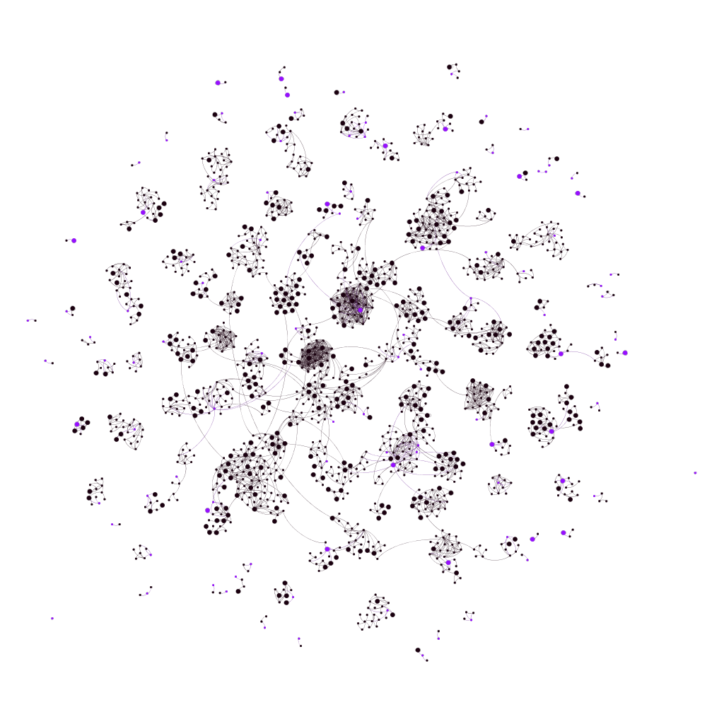
N3 Lab : Network Science for Networked Cities

Slide 4

https://rladieschicago.org/
https://www.meetup.com/rladies-chicago/

Slide 5
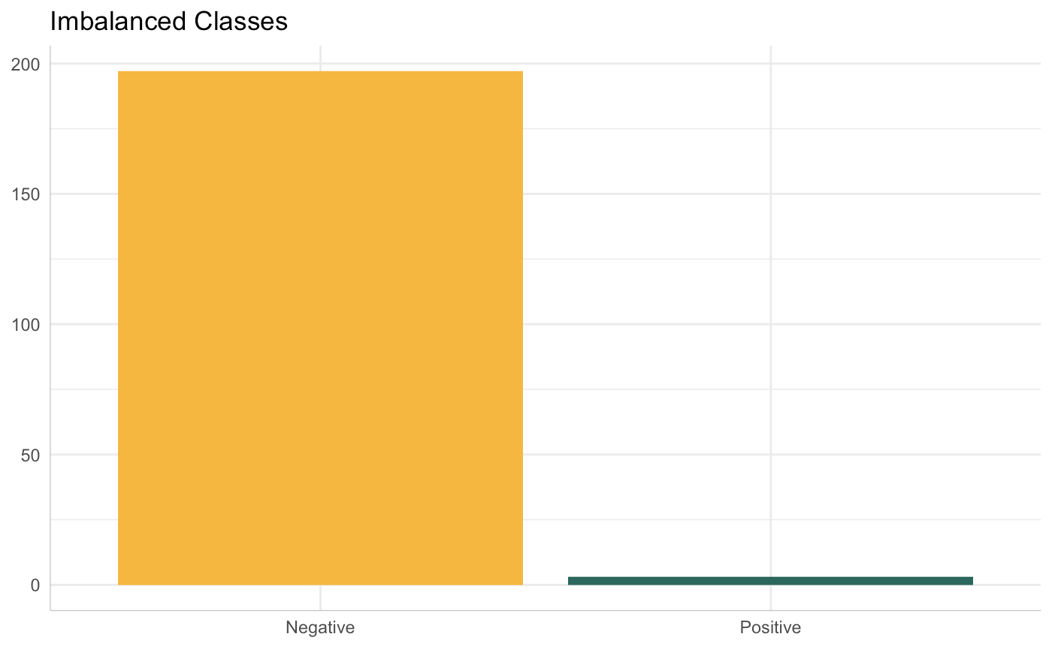
Class Imbalance - the class of interest is much rarer than the other class(es)
Fraud detection
Medical diagnoses
Risk Prediction

Slide 6
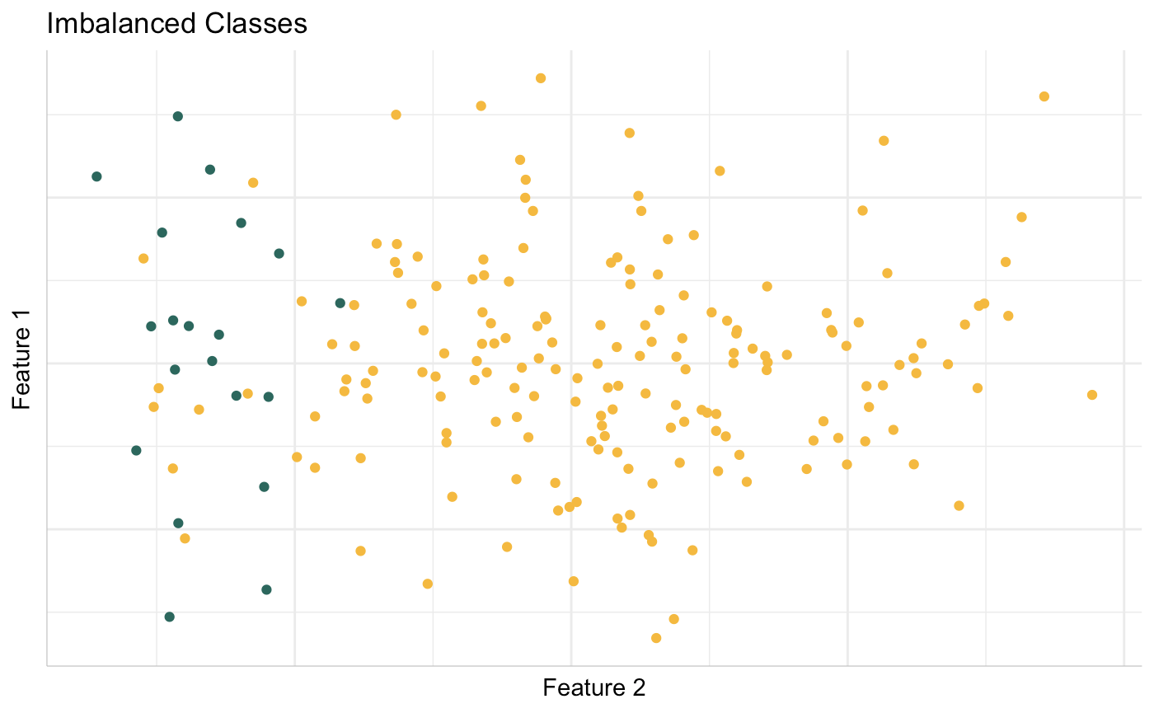
Data from https://github.com/scikit-learn-contrib/imbalanced-learn

Slide 7
Why is this a problem?

Slide 8
The cost of misclassifying a minority example can be higher.
Failure to identify a fraudulent transaction
Failure to identify an individual as high risk for post-surgical complications

Slide 9
Most model evaluation metrics assume balanced classes.
Accuracy of 98% ?
Dig deeper
Confusion matrix
Precision
Recall
ROC

Slide 10
Always look at the confusion matrix.
Predicted : Positive
Predicted : Negative
True Positive | False Negative
False Positive | True Negative
Actual : Positive
Actual : Negative

Slide 11
True Positives
Precision = ---------------------------------- Total Predicted Positives
What proportion of positive predictions made by the model were actually positive?

Slide 12
True Positives
Precision = ---------------------------------- True Positives + False Positives
What proportion of positive predictions made by the model were actually positive?

Slide 13
True Positives
Recall = -------------------------------- Total Actual Positives
Of all observations that were actually positive, how many did our model identify as positive?

Slide 14
True Positives
Recall = -------------------------------- True Positives + False Negatives
Of all observations that were actually positive, how many did our model identify as positive?

Slide 15
Notation and Metrics
Negative = 0 = Majority
Positive = 1 = Minority
We care about
Precision on Majority
Recall on Minority

Slide 16
Blindly Predict Negative

Slide 17
Blindly Predict Negative
Predicted : Positive
Predicted : Negative
True Positive 0 | False Negative 10
False Positive 0 | True Negative 90
Actual : Positive
Actual : Negative

Slide 18
Blindly Predict Positive

Slide 19
Blindly Predict Positive
Predicted : Positive
Predicted : Negative
True Positive 10 | False Negative 0
False Positive 90 | True Negative 0
Actual : Positive
Actual : Negative

Slide 20
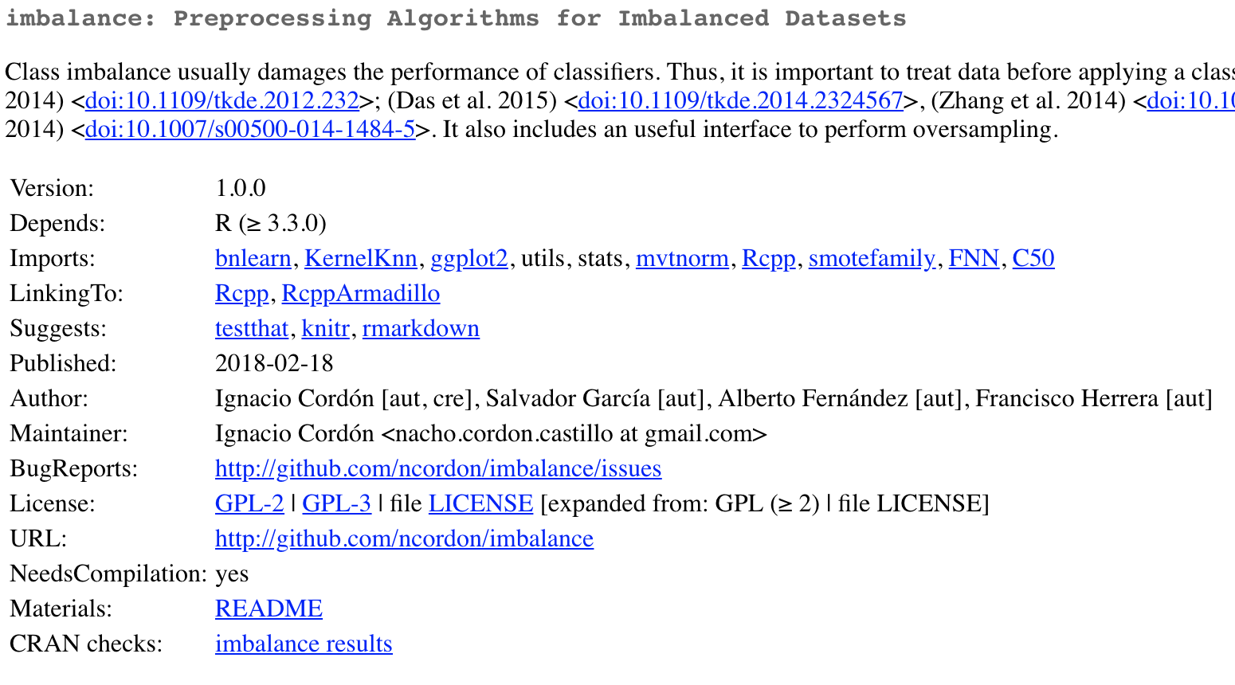
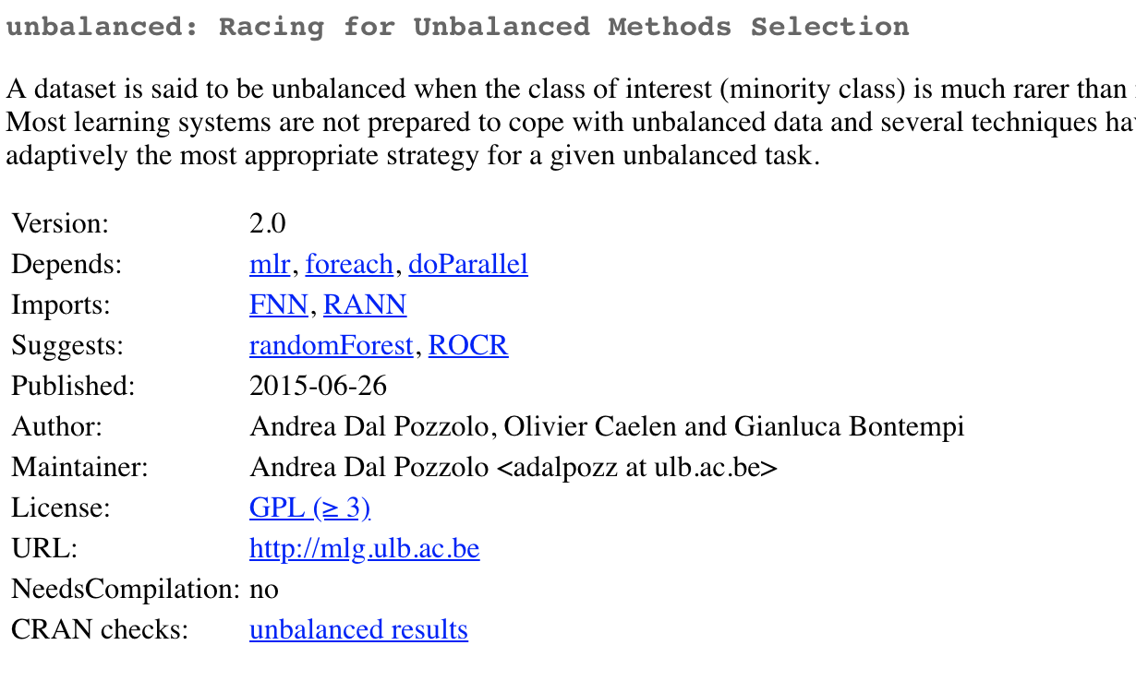
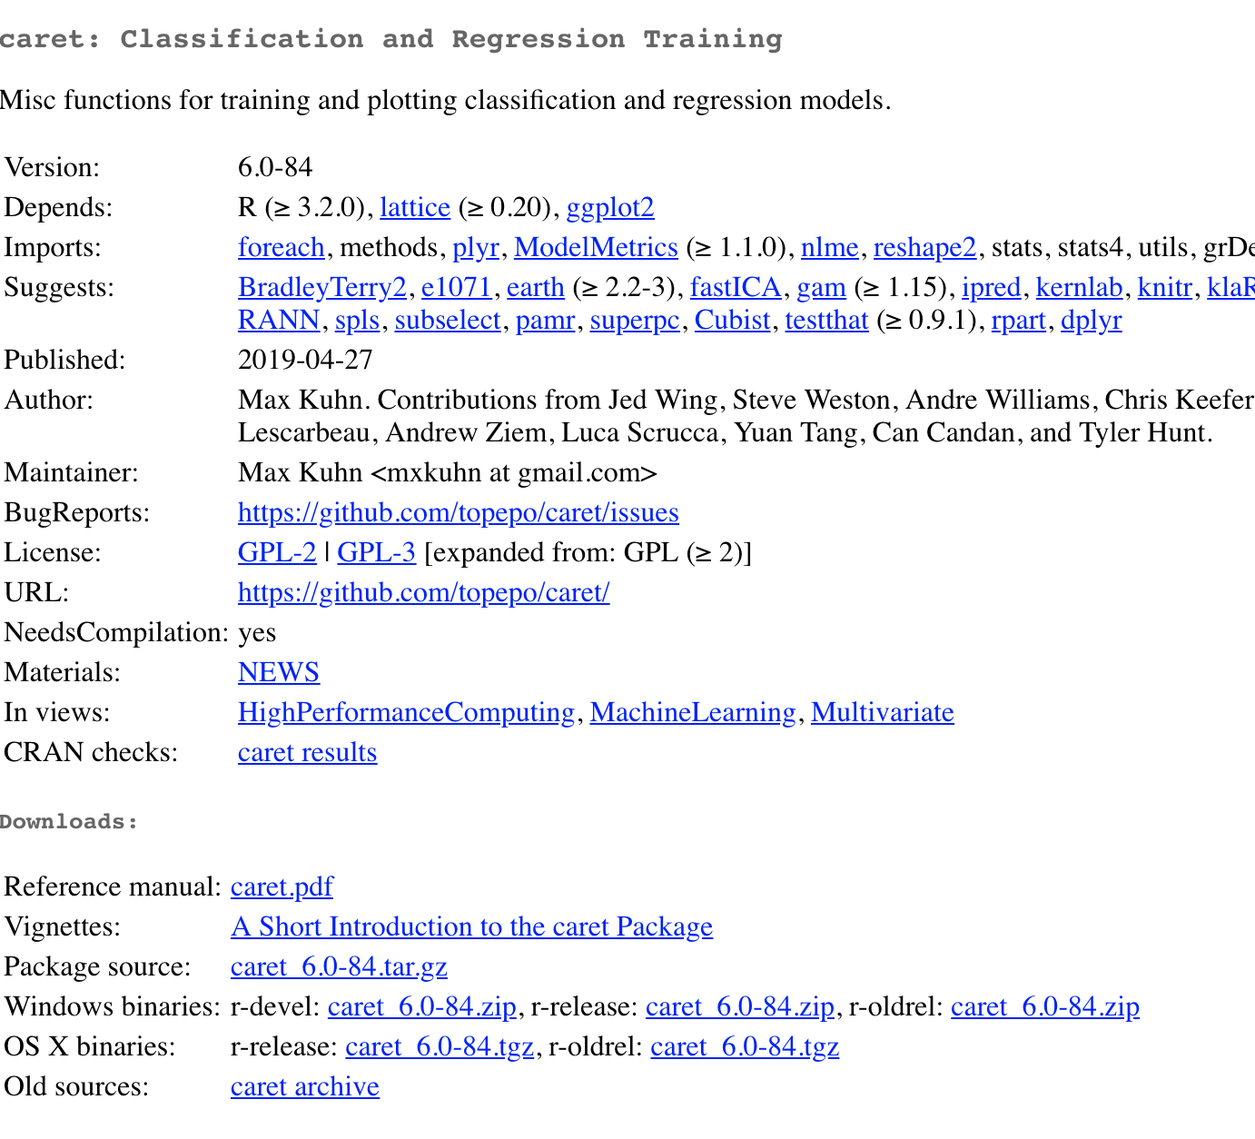
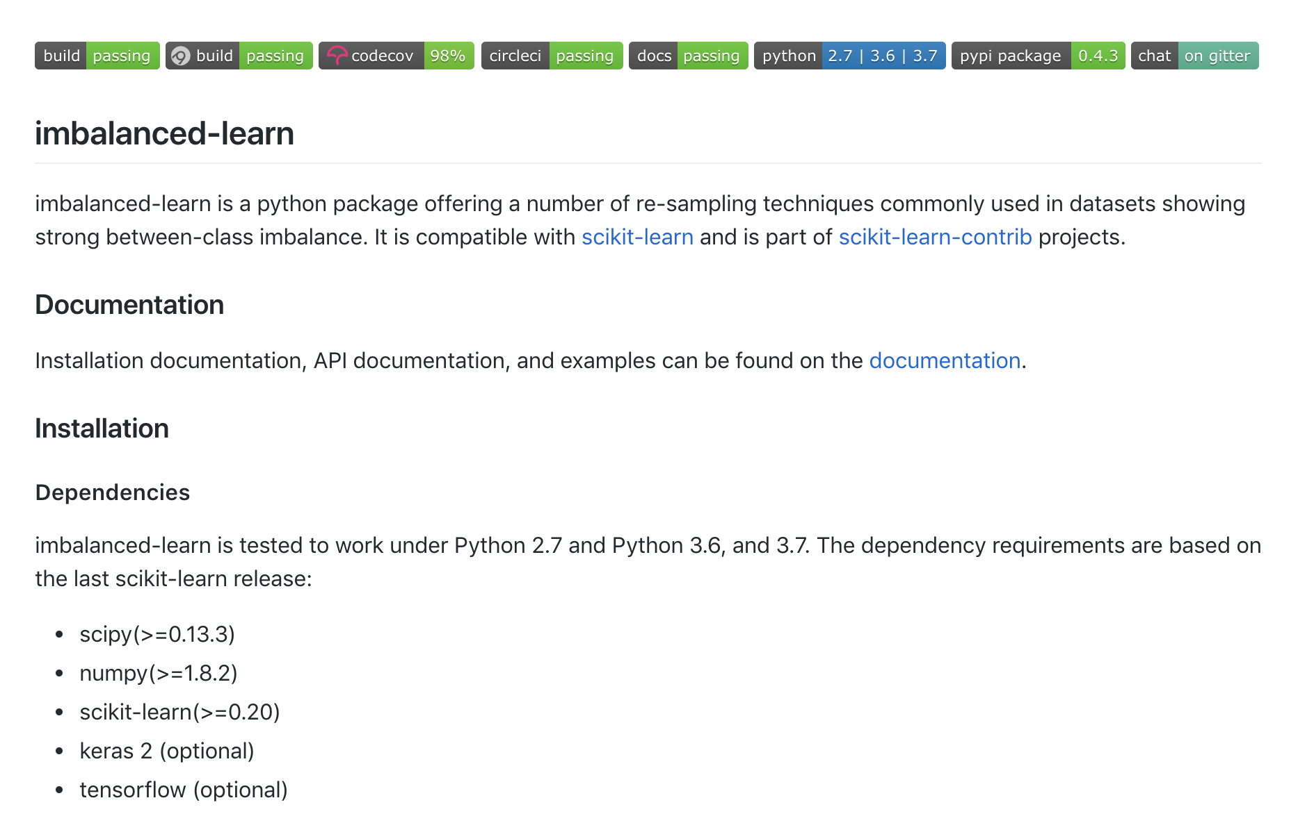

Slide 21
What can you do?
‘Data Mining’ Solutions
Modify your dataset
Machine Learning Solutions
Cost sensitive learning
Ensemble methods

Slide 22
Datasets for Today
Synthetically generated from (📦scikitlearn)
9:1
PCA-transformed to 2 features
Ionosphere (📦unbalanced)
2:1
33 features

Slide 23
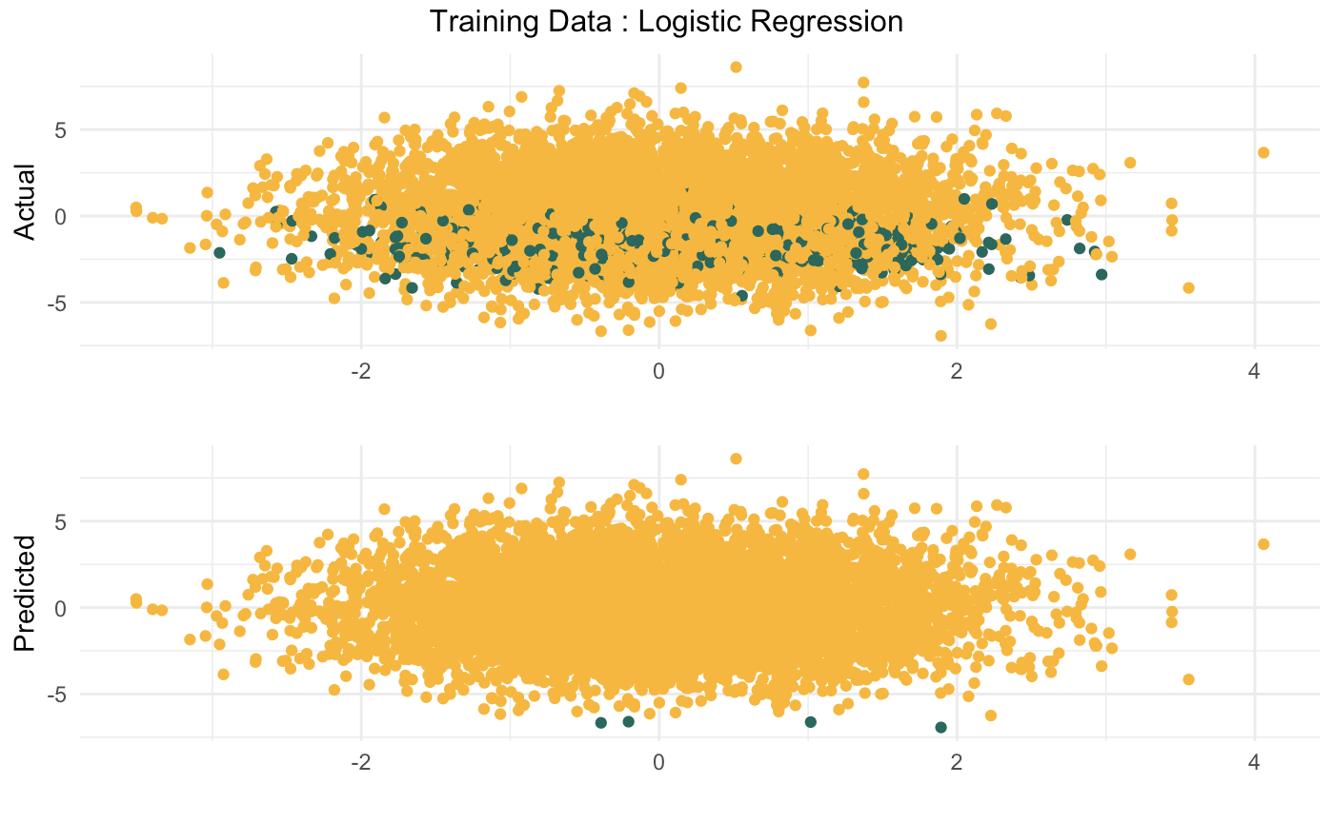
Baseline - Training Data

Slide 24
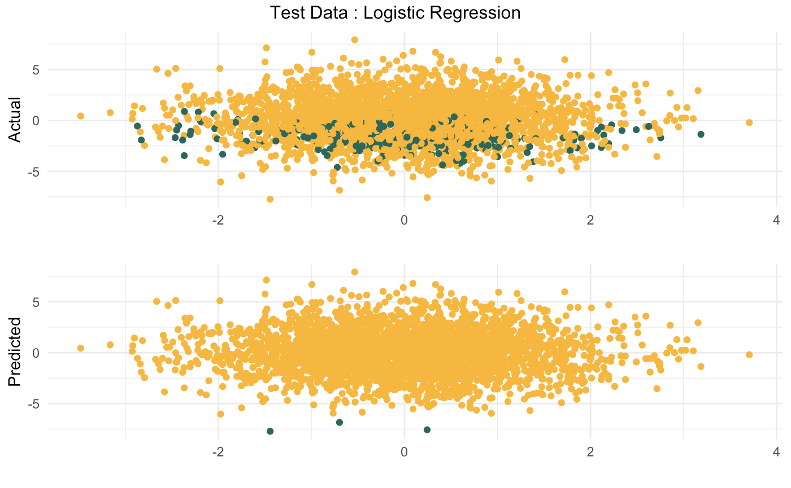
Baseline - Testing Data

Slide 25
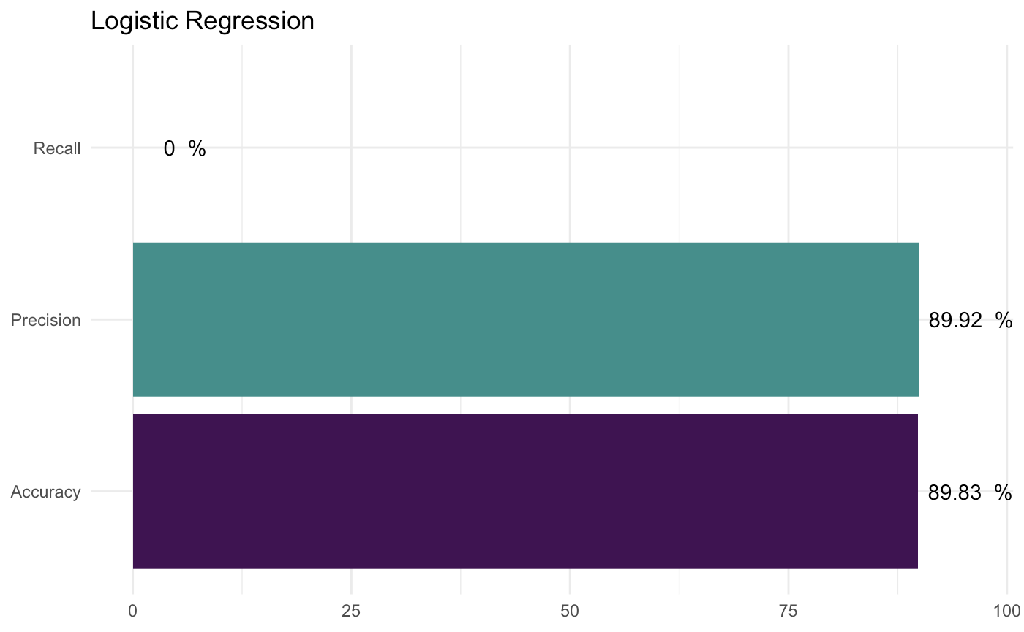
Baseline - Metrics

Slide 26
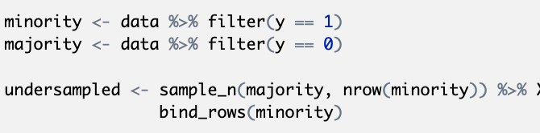
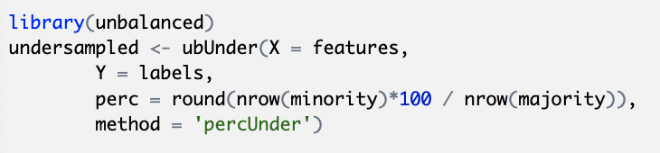
Random Undersampling

Slide 27
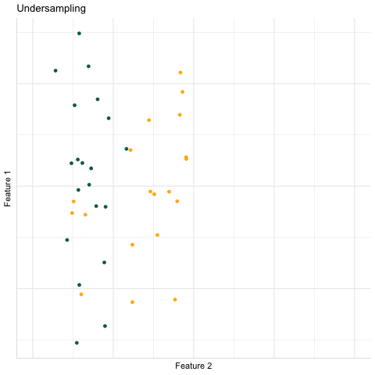
Random Undersampling
Throwing away good data
Decision boundary changes with chosen subset
Cross-validate

Slide 28
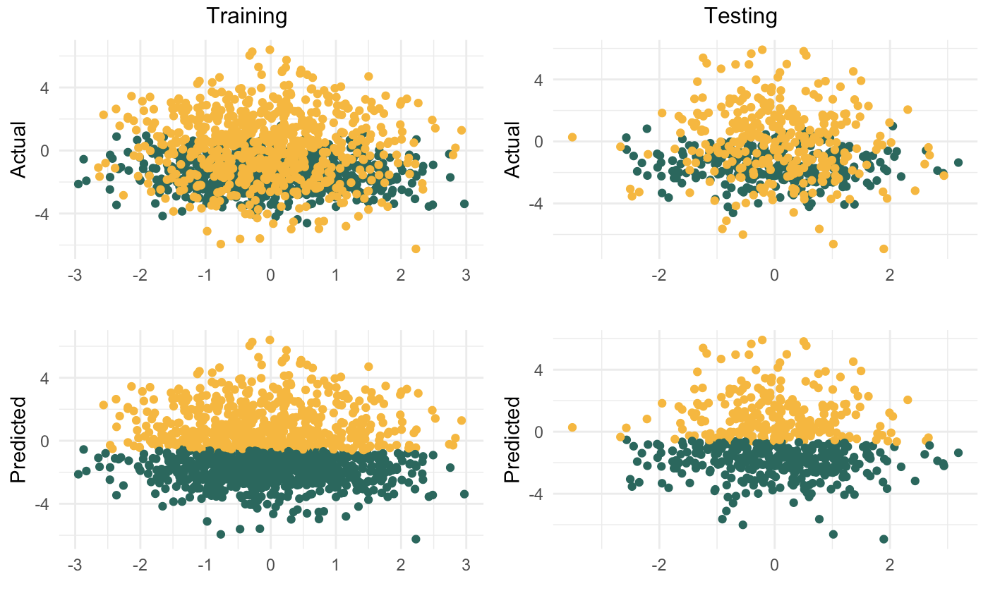
Random Undersampling

Slide 29
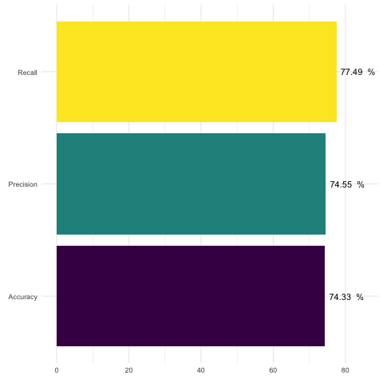
Random Undersampling

Slide 30
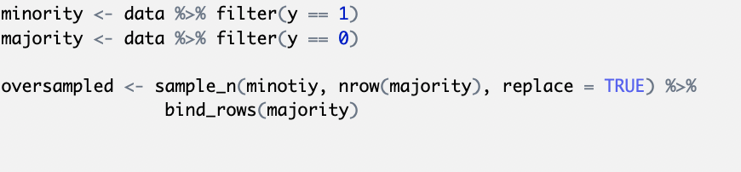
Random Oversampling

Slide 31
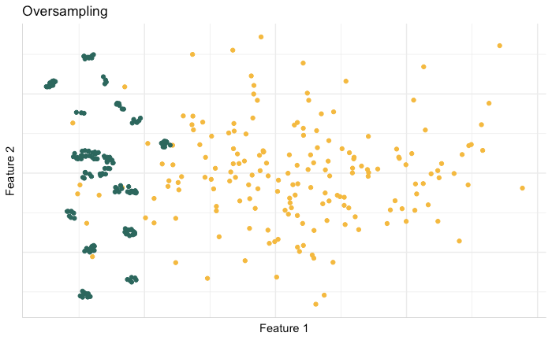
Somewhat similar to re-weighting (with a little randomness)
More data ≠more information
Undue emphasis on outliers
Risk of overfitting

Slide 32
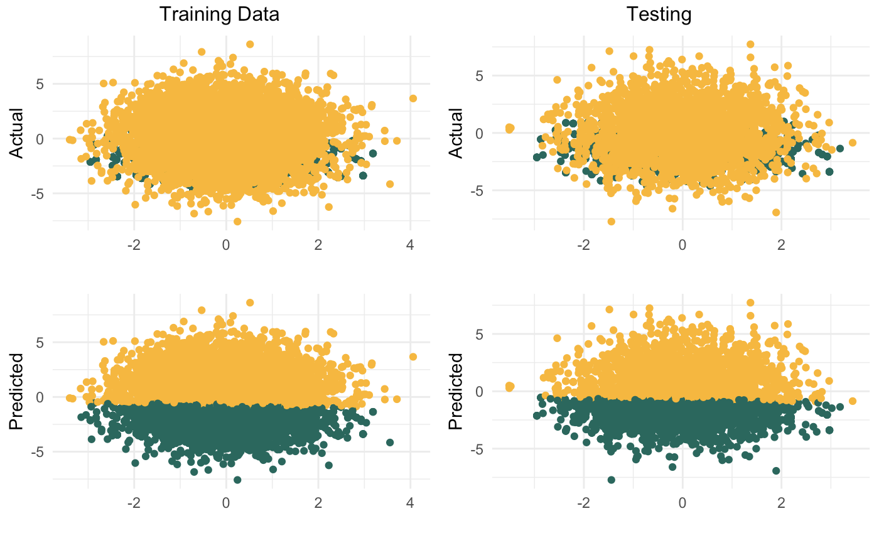
Random Oversampling

Slide 33
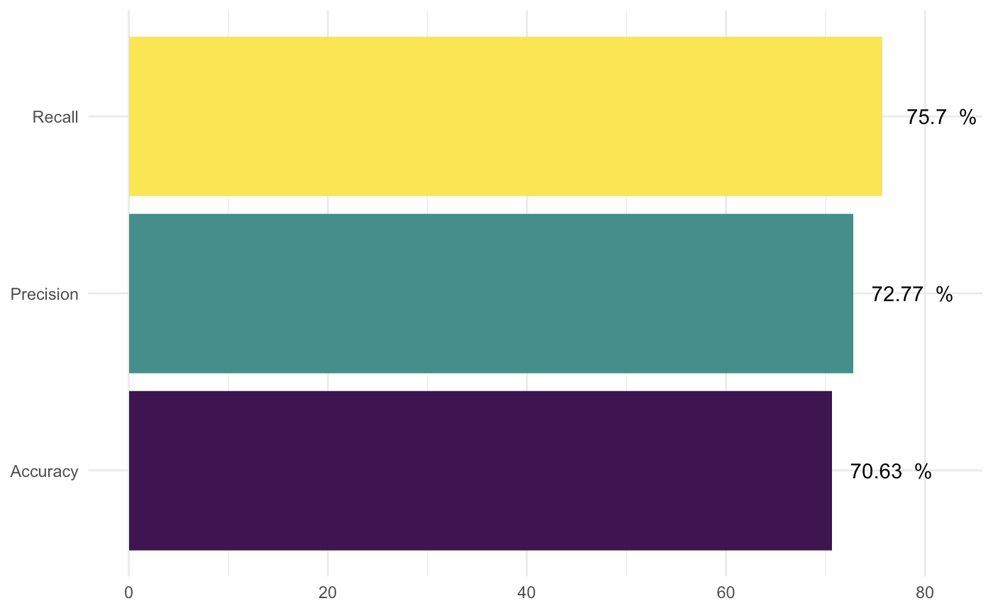
Random Oversampling

Slide 34
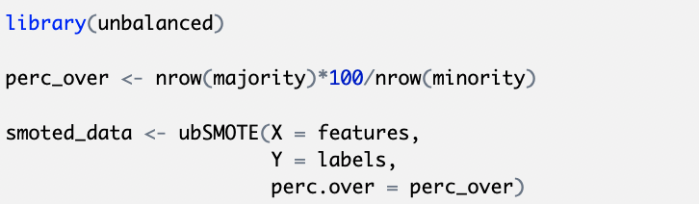
Synthetic Minority Oversampling Technique (SMOTE)
Chawla, Nitesh V, Kevin W Bowyer, Lawrence O Hall, and W Philip Kegelmeyer, “SMOTE: synthetic minority over-sampling technique,” Journal of Artificial Intelligence Research, 2002, 16, 321–357.

Slide 35
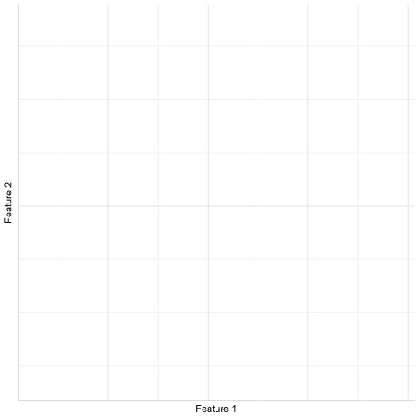
New data points through interpolation
Less overfitting
New points lie within same convex space

Slide 36
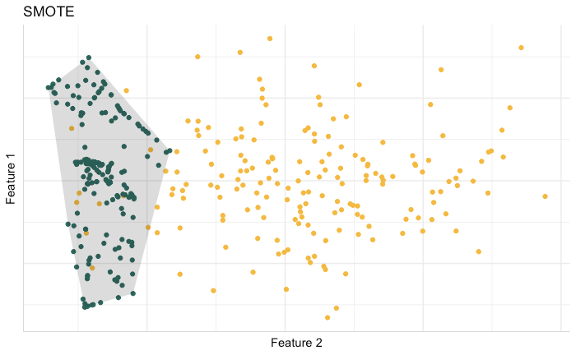

Slide 37
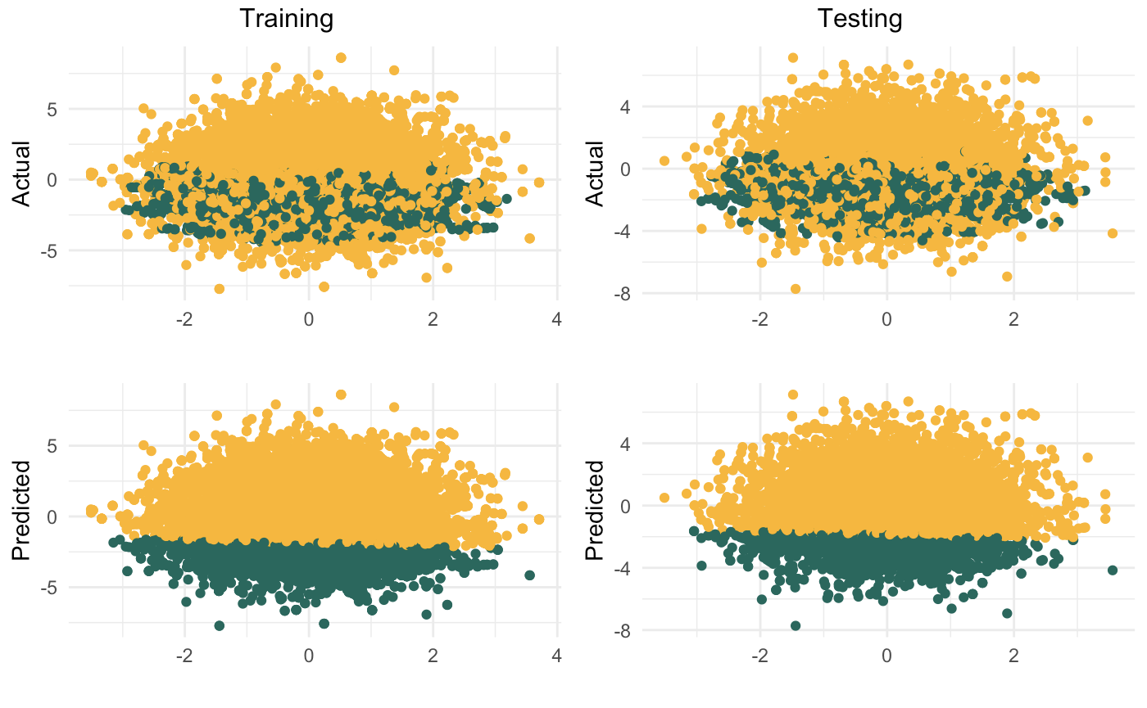
SMOTE

Slide 38
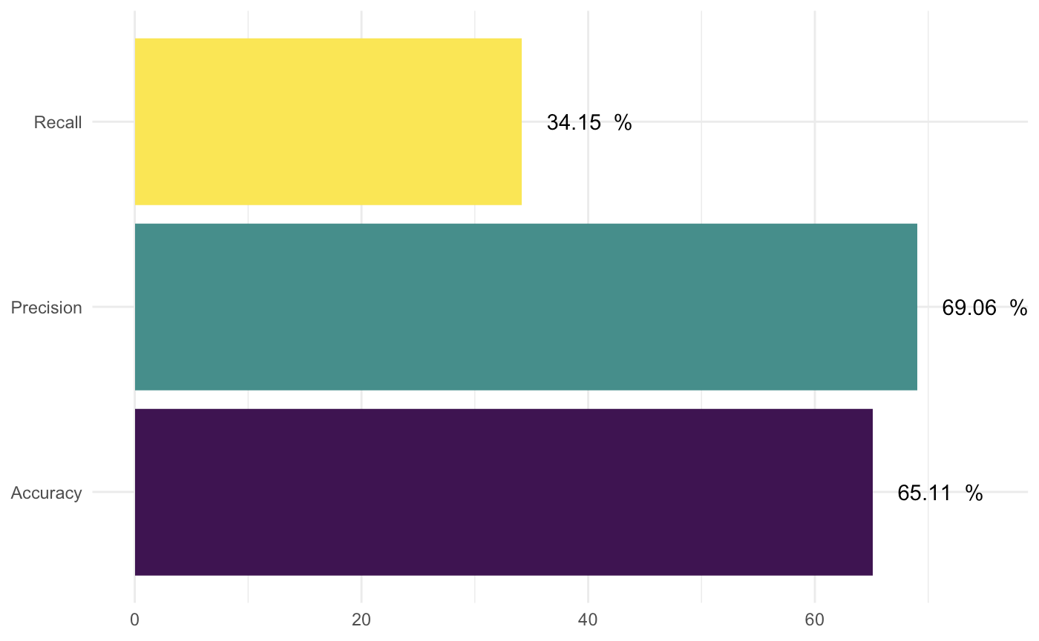
SMOTE

Slide 39
Removing TOMEK Links
Disambiguate class boundaries
A pair of observations forms a TOMEK link if
They are each other’s nearest neighbour
They have different class labels
I. Tomek, “An experiment with the edited nearest-neighbor rule,” IEEE Transactions on Systems, Man, and Cybernetics Part C, vol. 6, no. 6, pp. 448–452, 1976.

Slide 40
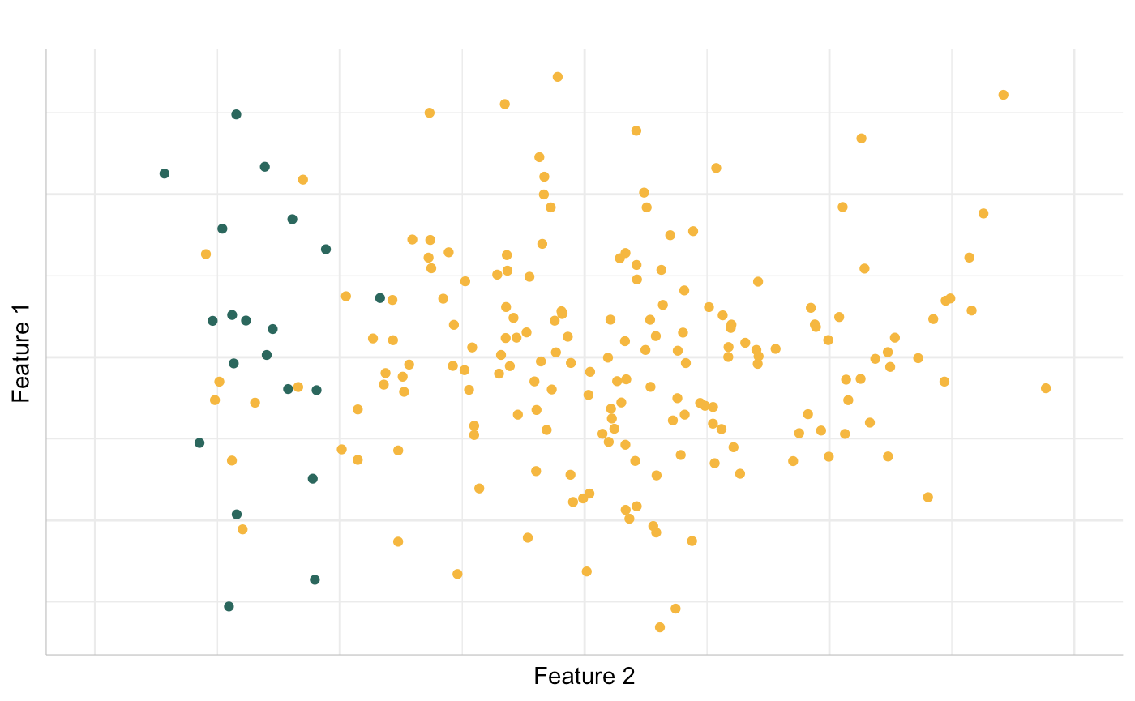
Removes noisy borderline examples
Works best in conjunction with some oversampling / adaptive learning algorithms

Slide 41
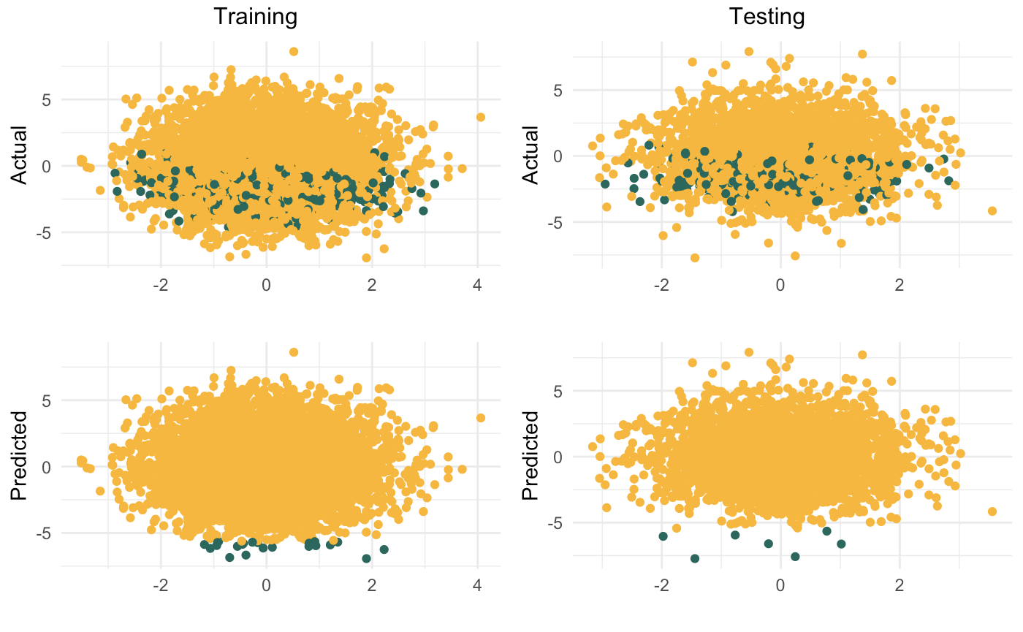
Removing TOMEK Links

Slide 42
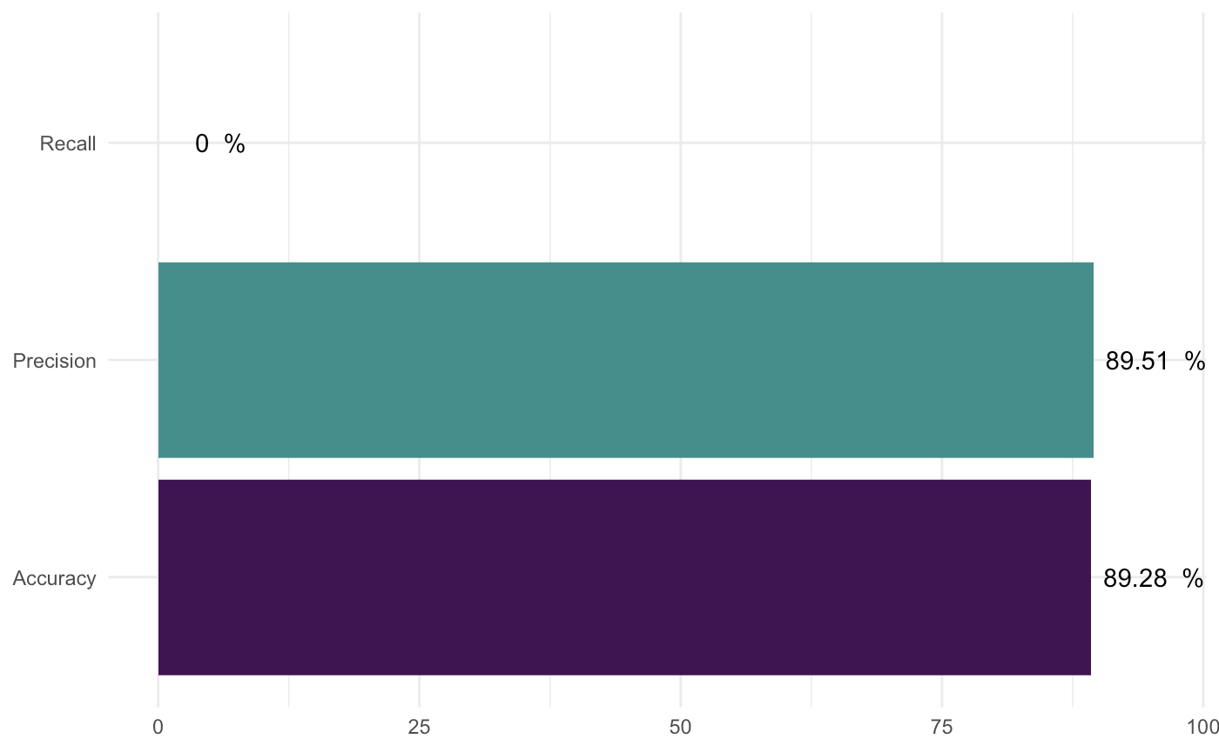
Removing TOMEK Links

Slide 43
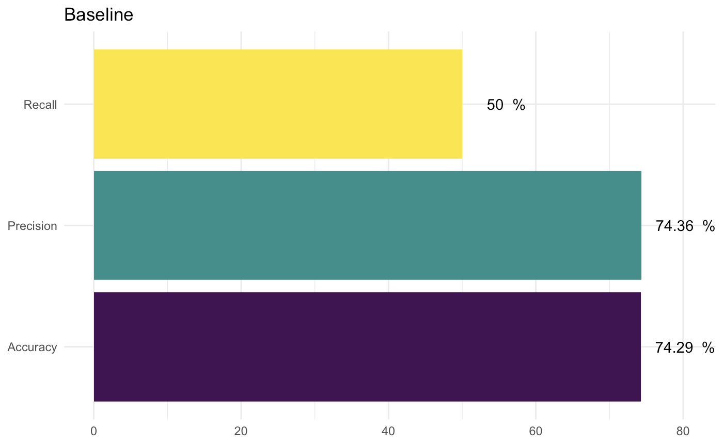
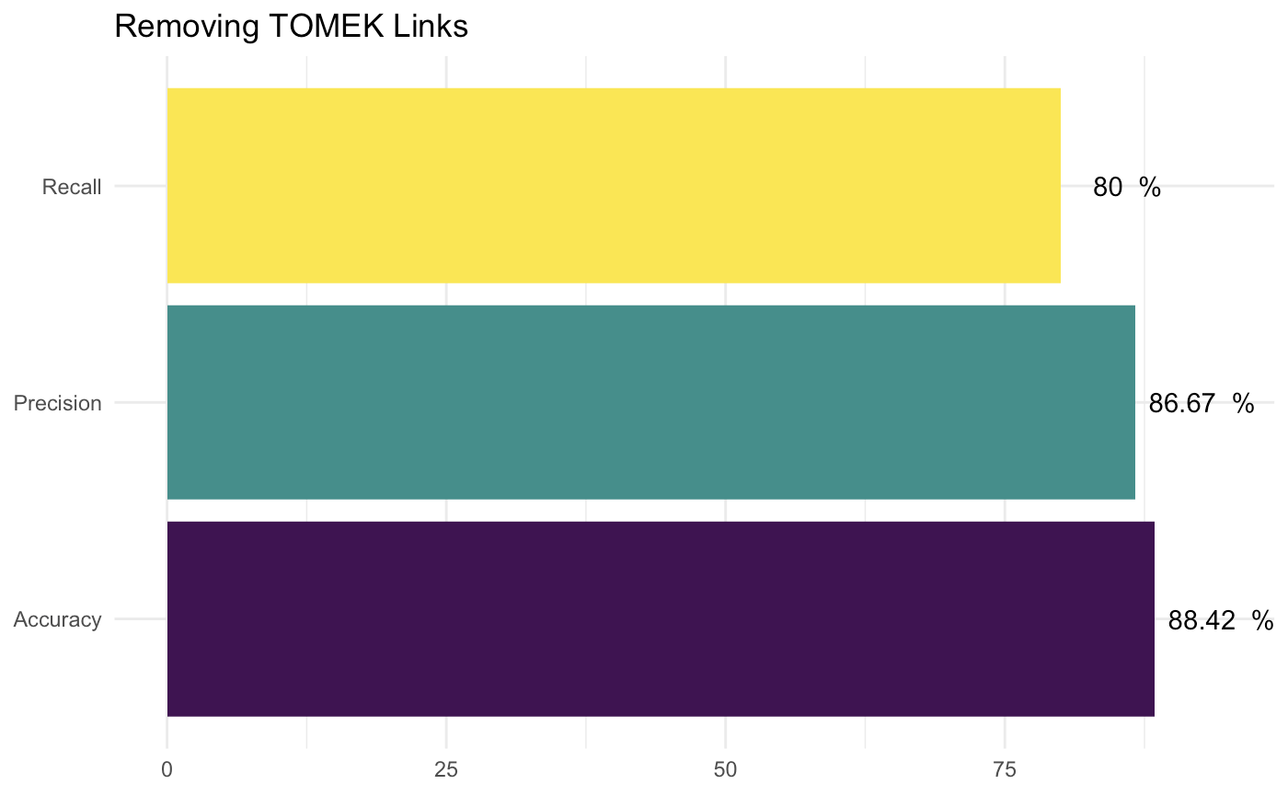
Removing TOMEK Links - Ionosphere

Slide 44
Edited Nearest Neighbours (ENN)
Take a point
Find its 3 nearest neighbours
If 2 out of 3 are different, remove that point.

Slide 46
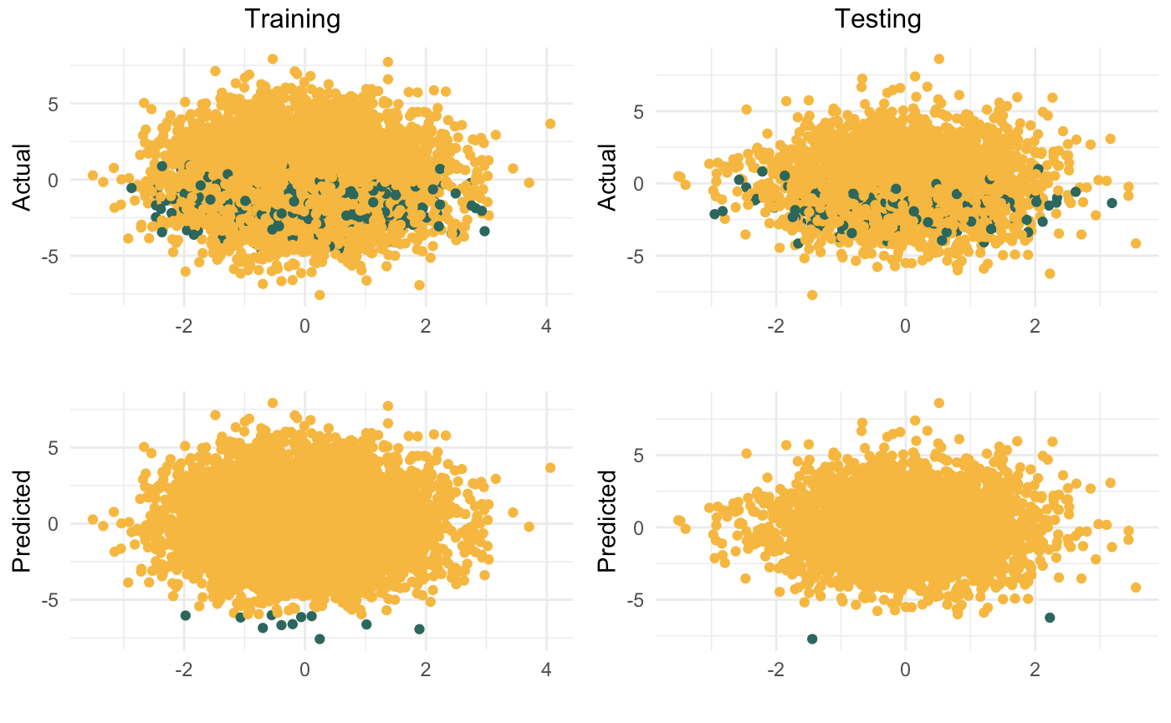
Edited Nearest Neighbour (ENN)

Slide 47
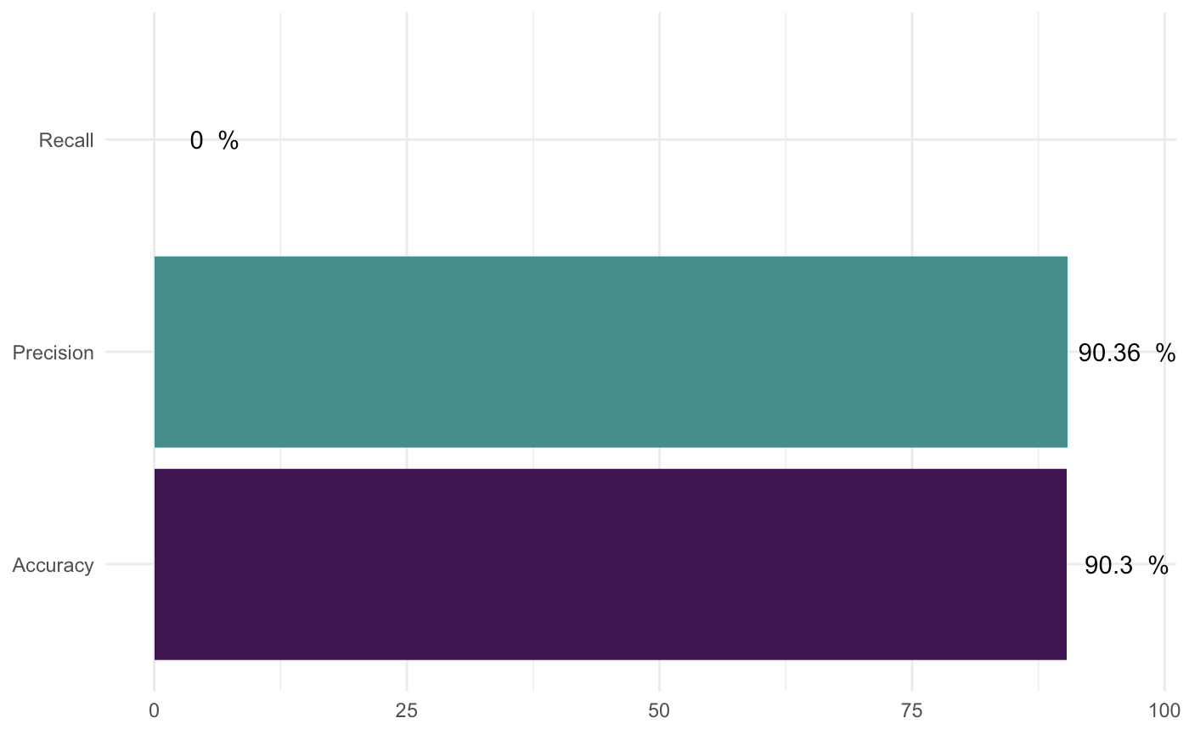
Edited Nearest Neighbour (ENN)

Slide 48
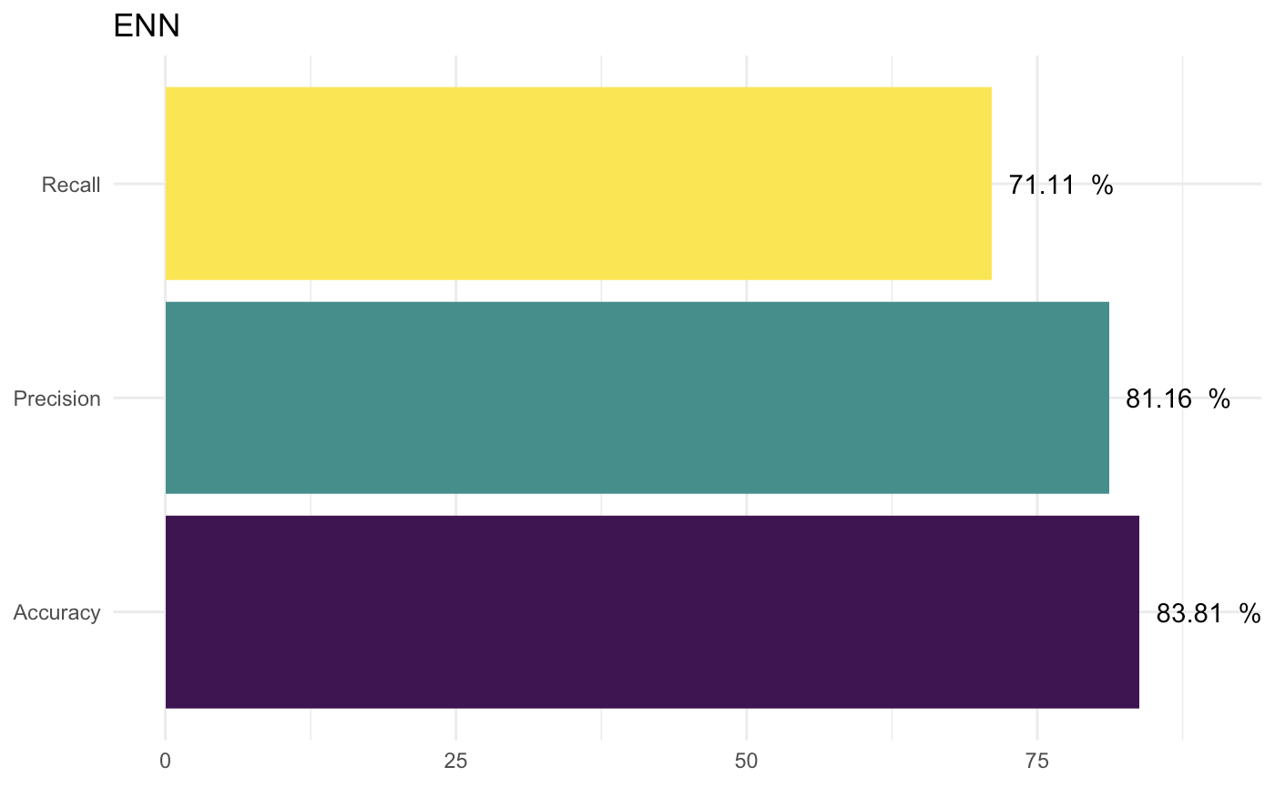
ENN - Ionosphere

Slide 49
Condensed Nearest Neighbours (CNN)
Undersampled set = U, training data = T
Take a point from T, put it in U
For every point in T, check if it is correctly classified by its NN in U
If yes, ignore
If not, add to U
Repeat until U no longer grows

Slide 50
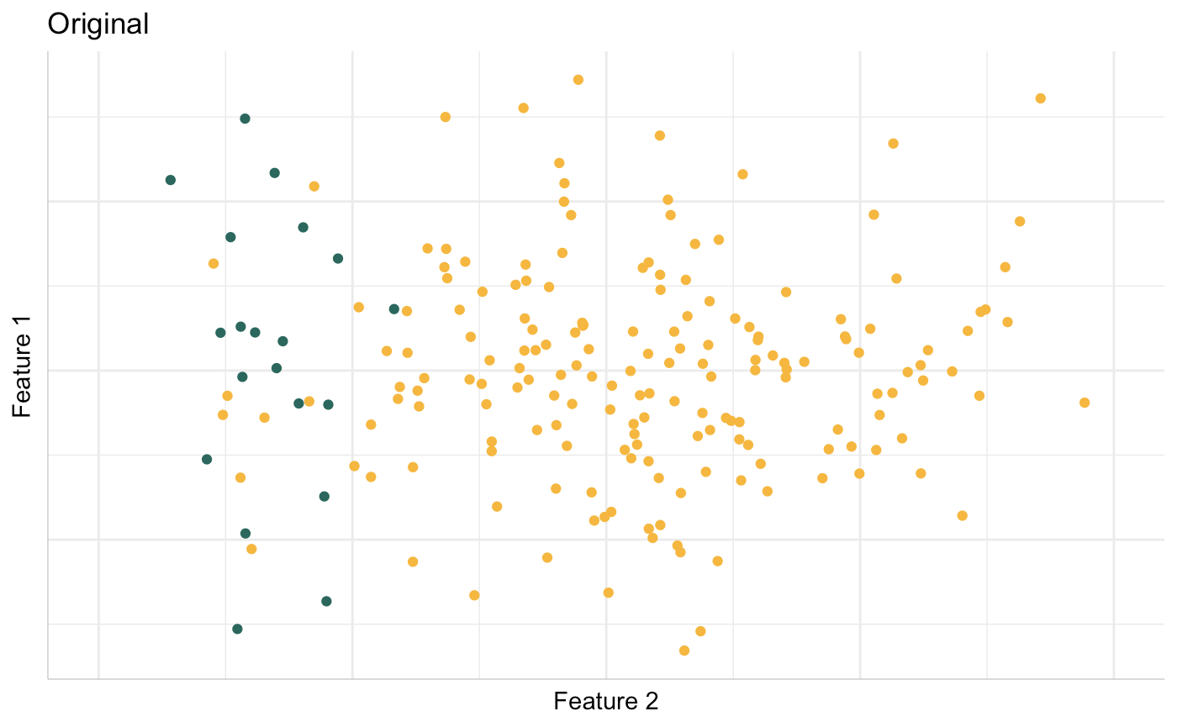
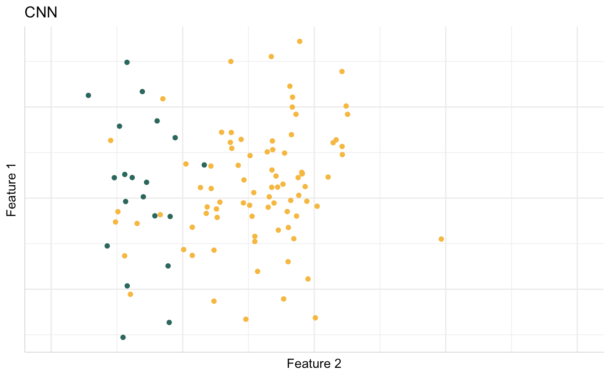
Condensed Nearest Neighbours (CNN)
Hart, Peter. "The condensed nearest neighbor rule (Corresp.)." IEEE transactions on information theory 14, no. 3 (1968): 515-516.

Slide 51
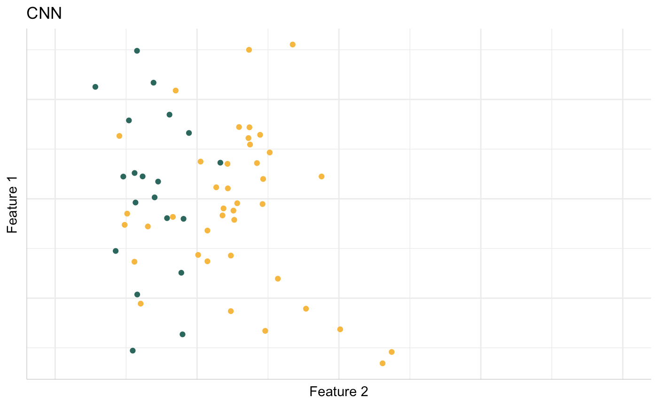
Condensed Nearest Neighbours (CNN)

Slide 52
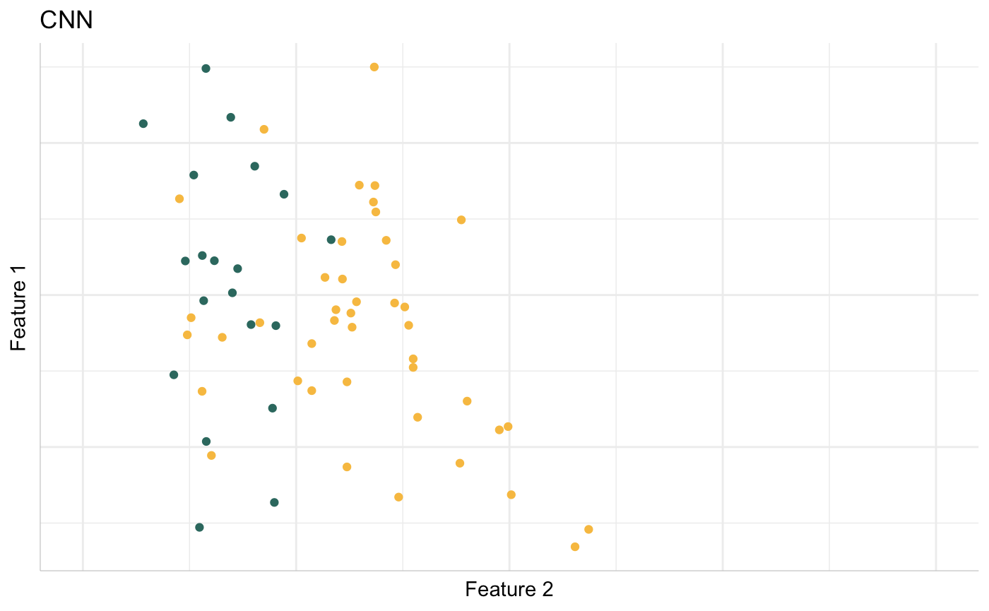
Condensed Nearest Neighbours (CNN)

Slide 53
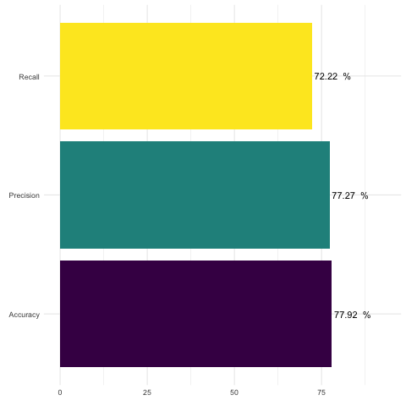
Condensed Nearest Neighbours (CNN)

Slide 54
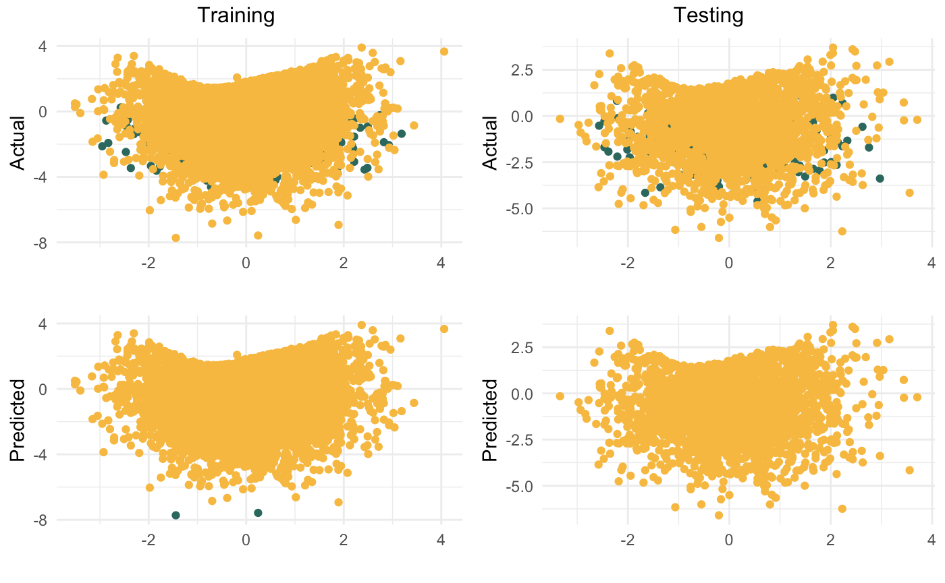
Condensed Nearest Neighbours (CNN)

Slide 55
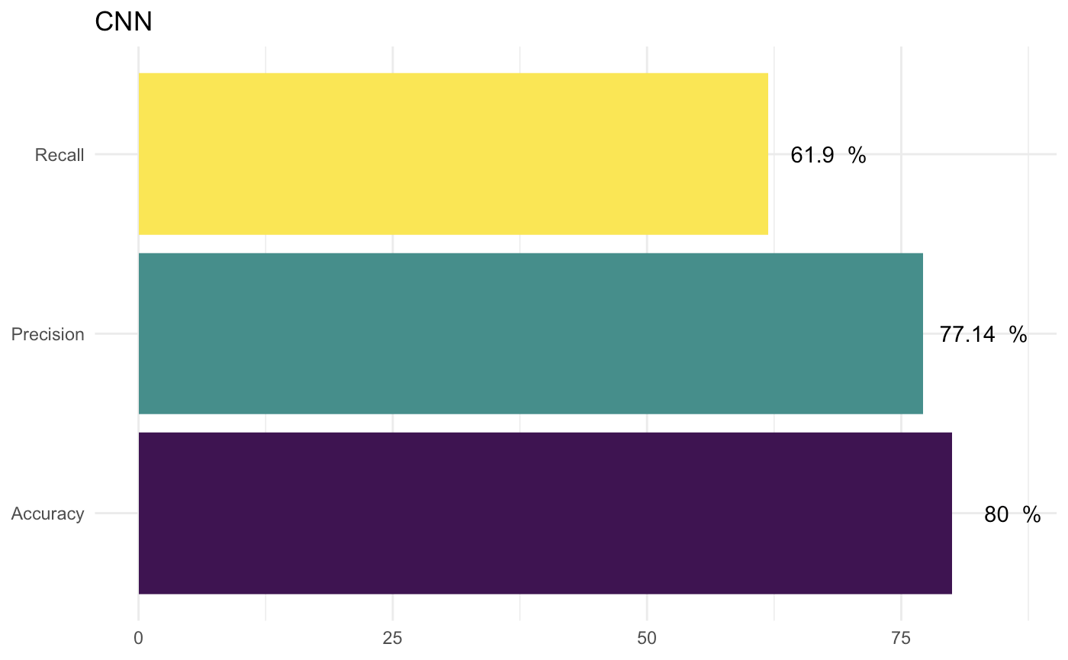
CNN - Ionosphere

Slide 56
Ensemble Methods!

Slide 57
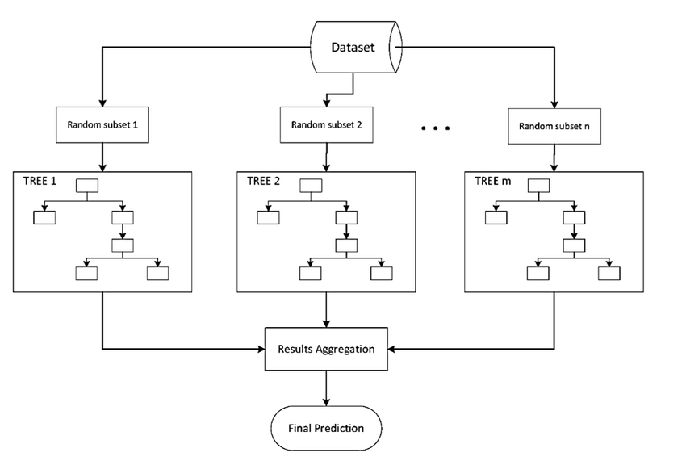
Ensemble Methods
Boosting
Bagging
Random Forest
AdaBoost
XGBoost

Slide 58
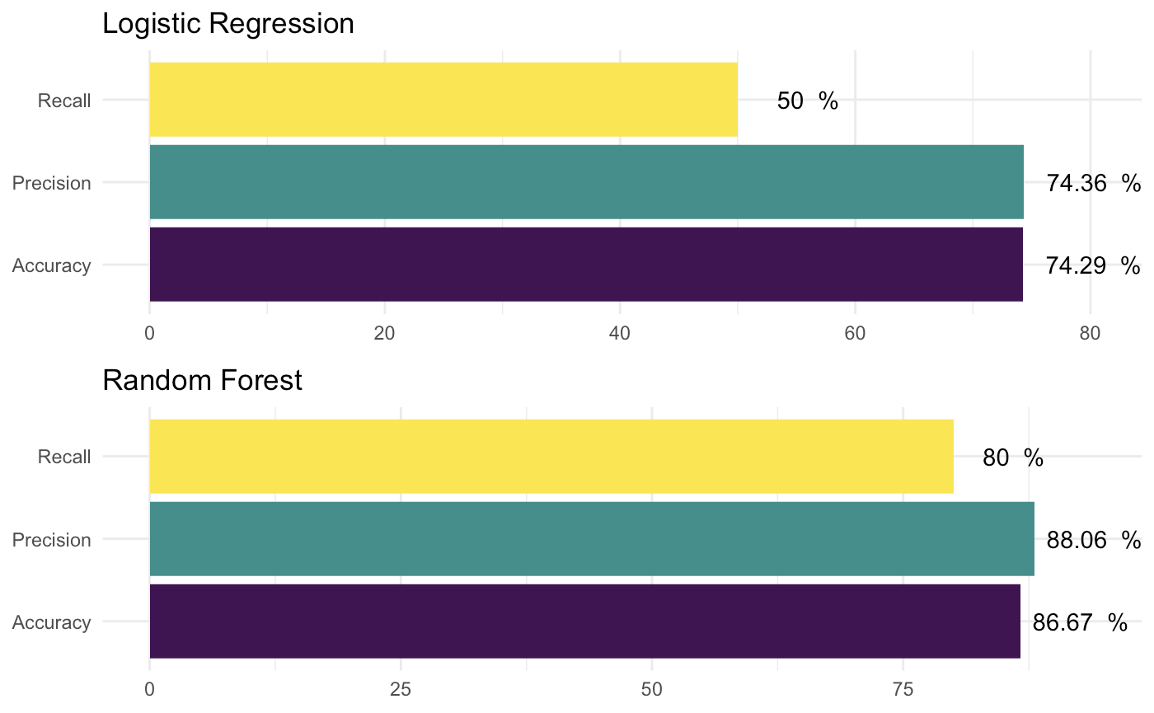
Ensemble Methods

Slide 59
EasyEnsemble
Use random undersampling to create a subset
Fit AdaBoost to this subset, make predictions on training test
Repeat N times
For each observation, obtain Mode of predictions from each single ensemble.

Slide 60
Balance Cascade
Use random undersampling to create a subset
Fit AdaBoost to this subset, make predictions on training test
Remove all examples that are correctly classified. Repeat N times.
Combine predictions

Slide 61
Stray Thoughts
Stratified Sampling
Weighted classification
Check the assumptions your package of choice is making
Usually, apply resampling method to your training split.

Slide 62
Predicting Infant Mortality:
Minimizing False Negatives

Slide 63
32 out of 1,000 babies born in India die within a year
Can we identify pregnant mothers at risk for infant death?
Some predictive variables -
Mother’s age
Time since previous birth
Anaemia

Slide 64
92.7 % accuracy from vanilla logistic regression
However, I was misclassifying 3 out of 4 high-risk pregnancies as safe!
Focus on minimizing False Negatives?
What are the trade-offs?
Class Imbalance Ratio - 93:7

Slide 65
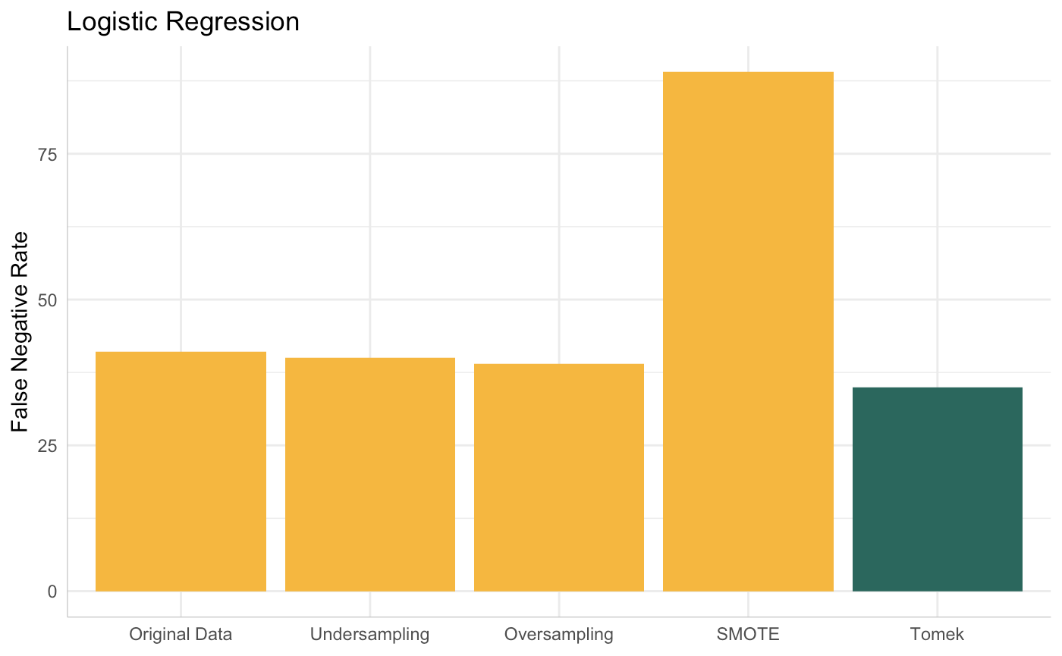
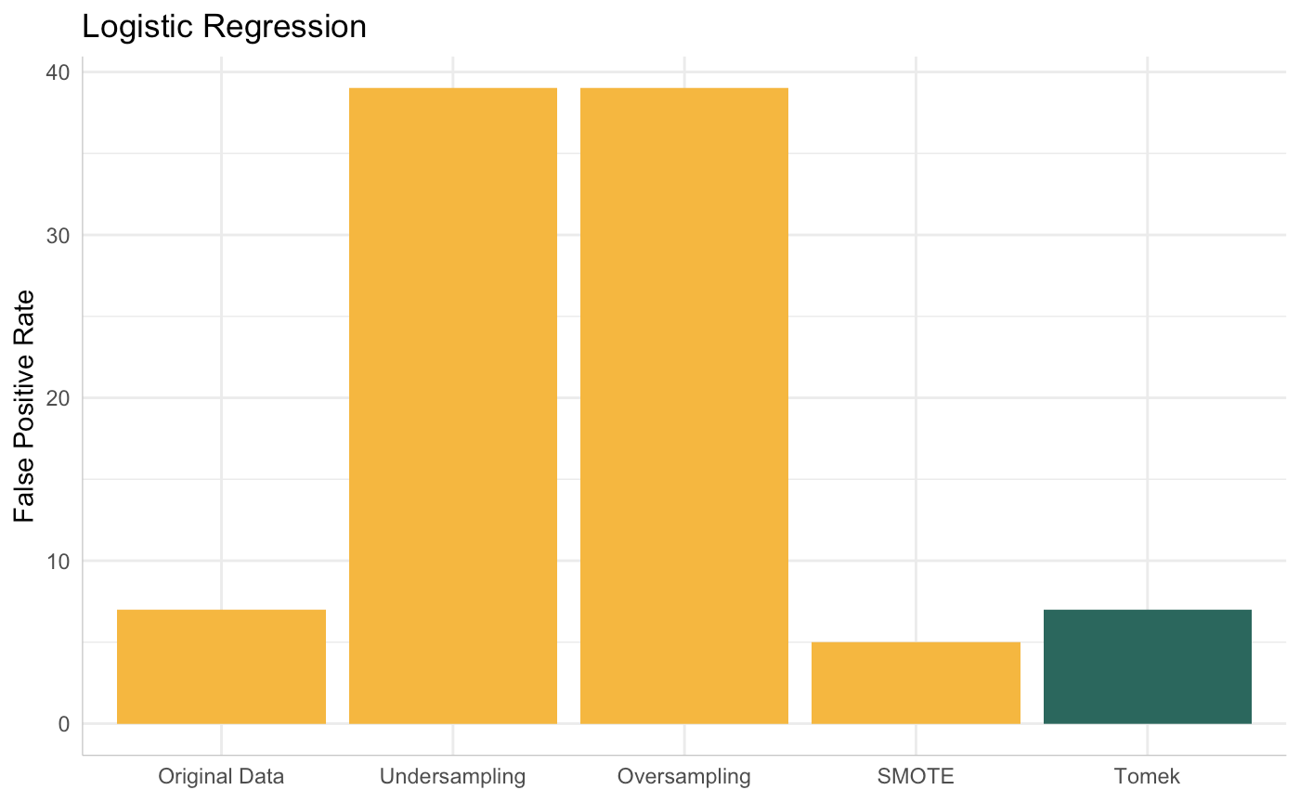
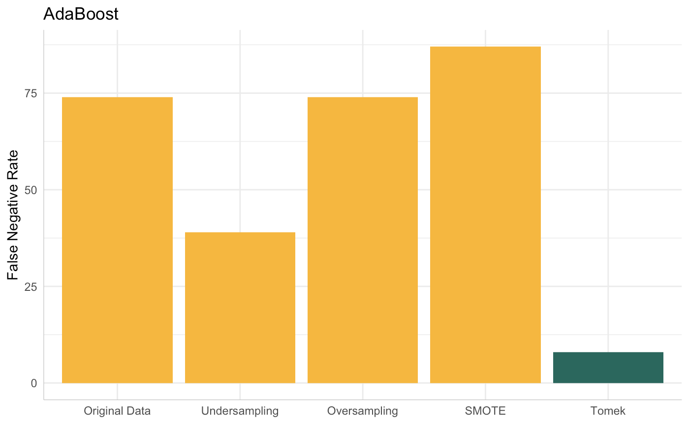
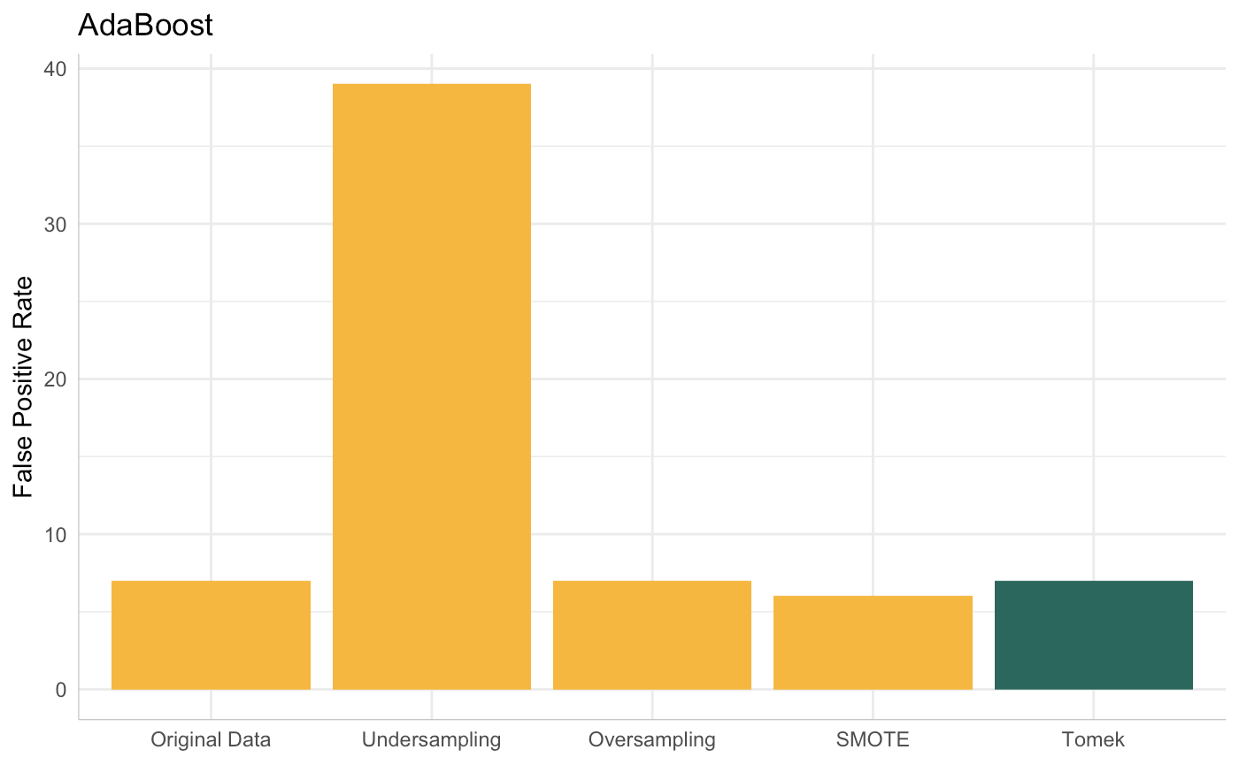

Slide 66
Why did removing Tomek Links + AdaBoost work best for THIS data, given THESE objectives?
Discarded only 0.2% of the data
Robust to cross-validation
Sick babies that survive can look very similar to sick babies that do not

Slide 67
How do you choose a strategy?
Know the structure of your data
Evaluate your trade-offs
Trial-and-error

Slide 68
Thank you!

